Slide 1

Intro to NLP and Deep Learning
신 병 주
bjshin@sejong.ac.kr
2018년 1월 2일

Slide 2
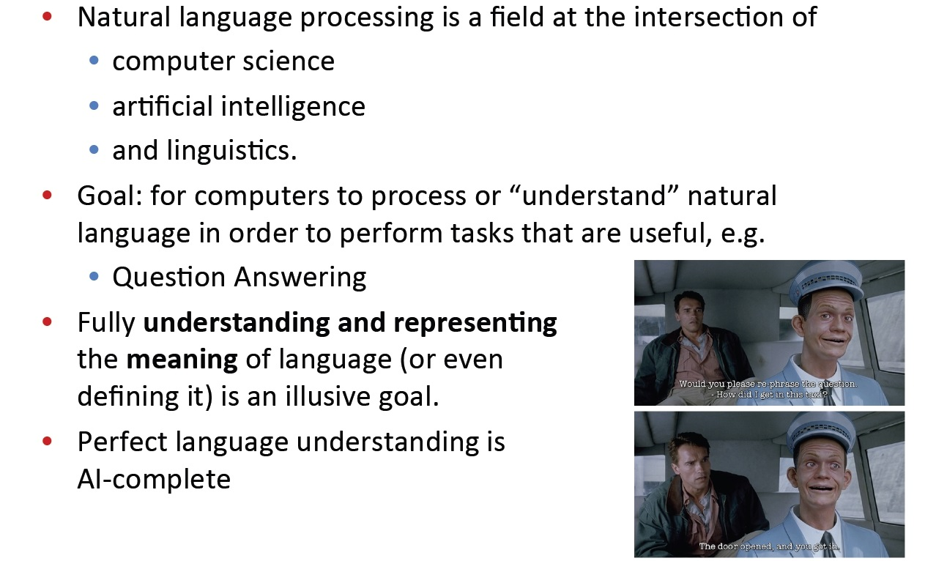
What is Natural Language Processing (NLP)?

Slide 3
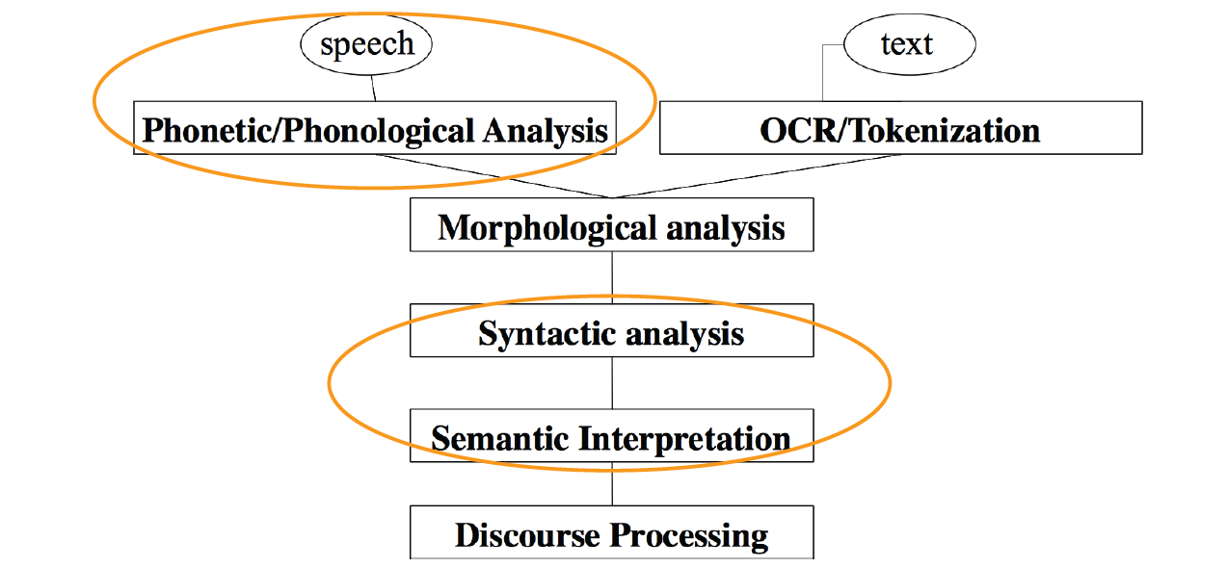
NLP Levels
언어의 소리(발음)에 관한 연구
ex) disconnect = dɪs-kə-nekt
의미를 가지는 가장 작은 단위인 형태소에 관한 연구
한국어는 어근과 접사에 의해 단어의 기능이 결정되는 교착어이므로 다른 언어에 비해 형태소 분석이 어려움
단어들의 관계 구조에 관한 연구
구문 분석기에 활용
문장의 의미 분석에 대한 연구
ex) I know that you and Frank were planing to disconnect me
Action: disconnect
Actor: you and Frank
Object: me
Sentence와 Sentence의 관계에 대한 연구

Slide 4
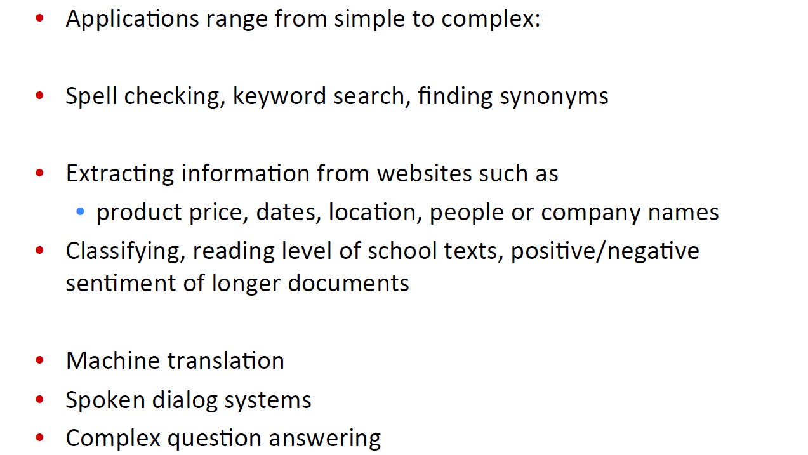
(A tiny sample of) NLP Applications

Slide 5
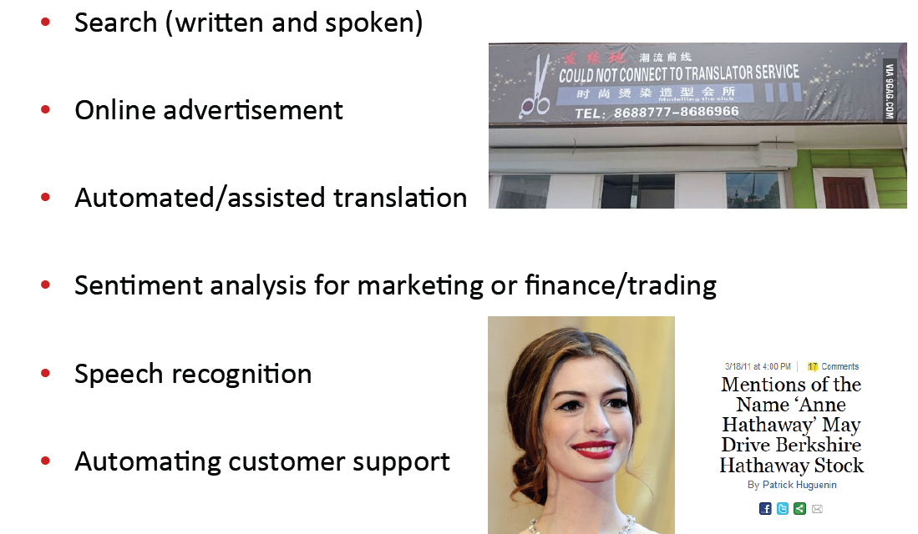
NLP in Industry

Slide 6
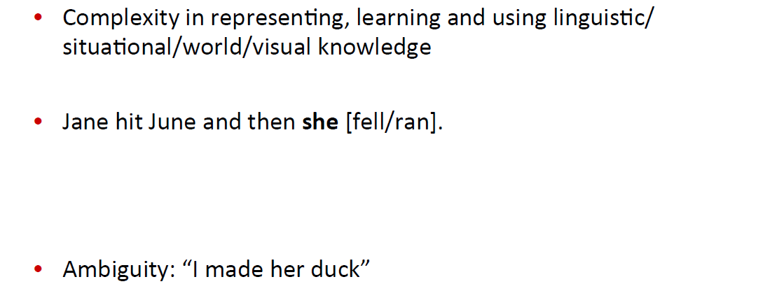
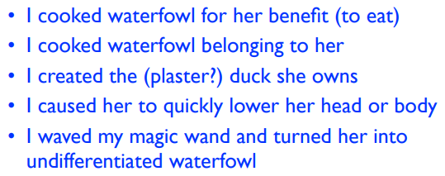
Why is NLP hard?

Slide 7
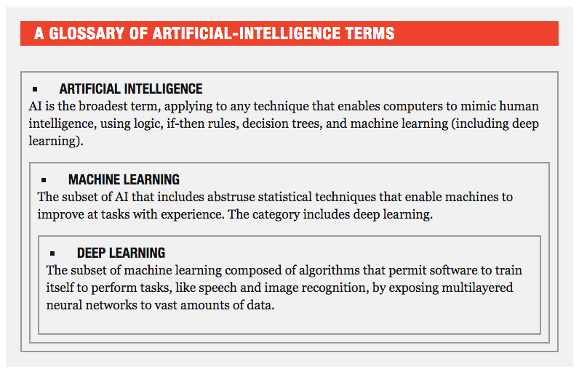
What’s Deep Learning (DL)?

Slide 8

What’s Deep Learning (DL)?

Slide 9
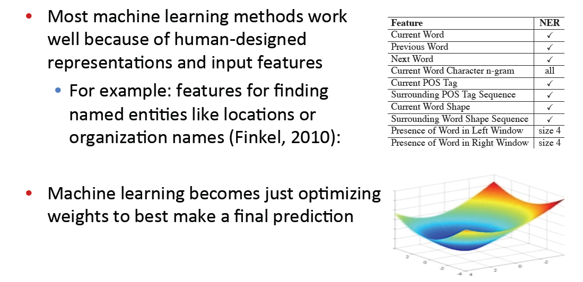
What’s Deep Learning (DL)?

Slide 10
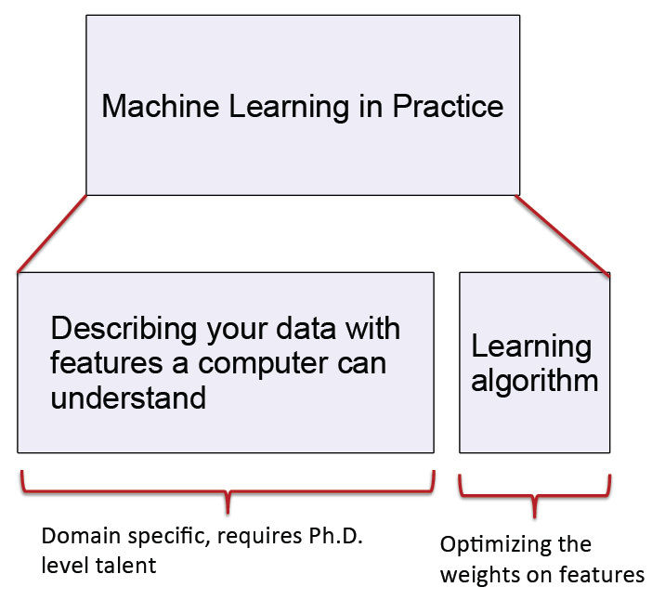
Machine Learning vs Deep Learning

Slide 11
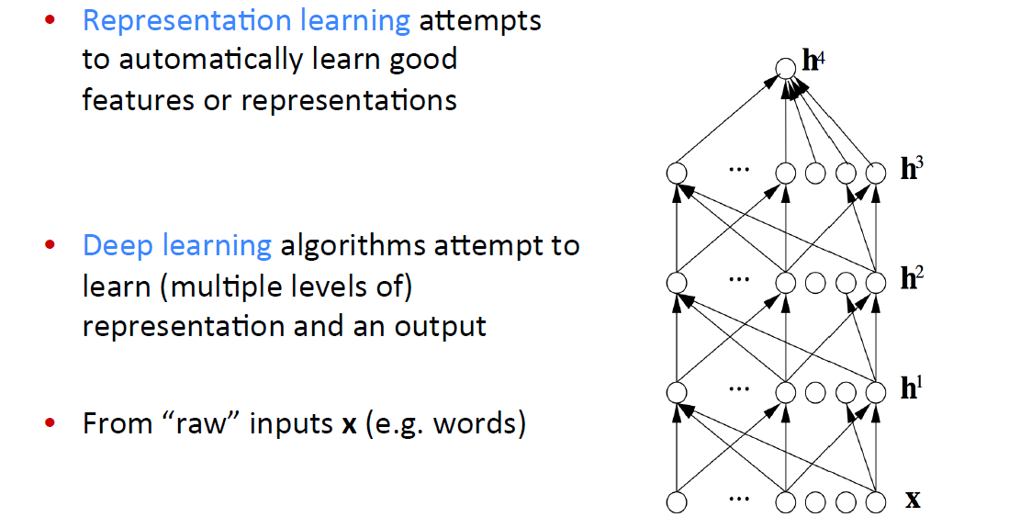
What’s Deep Learning (DL)?

Slide 12
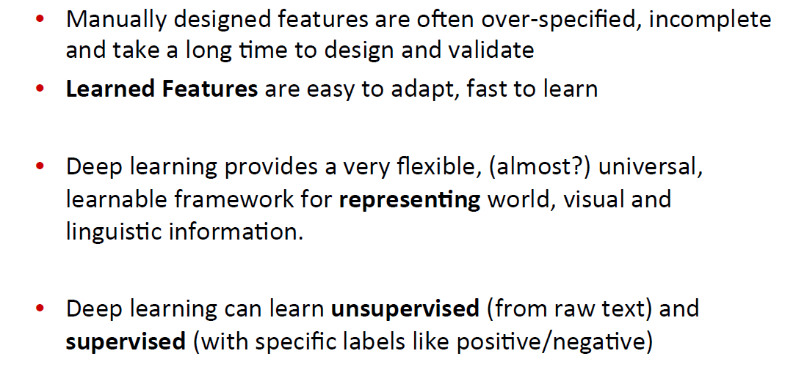
Reasons for Exploring Deep Learning
Supervised Learning : Convolutional Neural Networks(CNNs)
Recurrent Neural Networks(RNNs)
Unsupervised Learning : Autoencoders

Slide 13
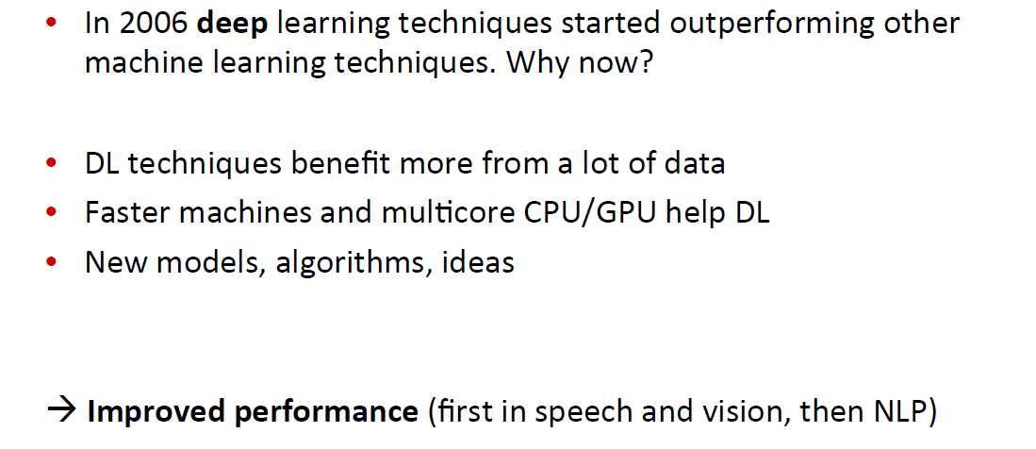
Reasons for Exploring Deep Learning

Slide 14
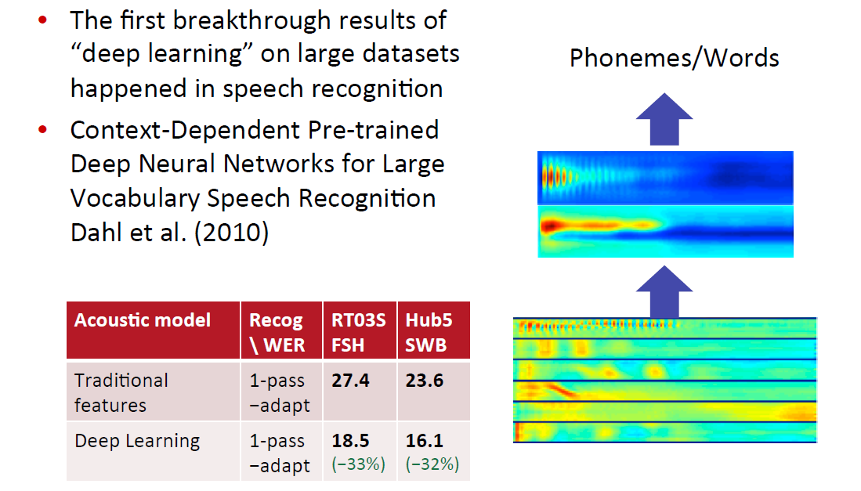
Deep Learning for Speech

Slide 15
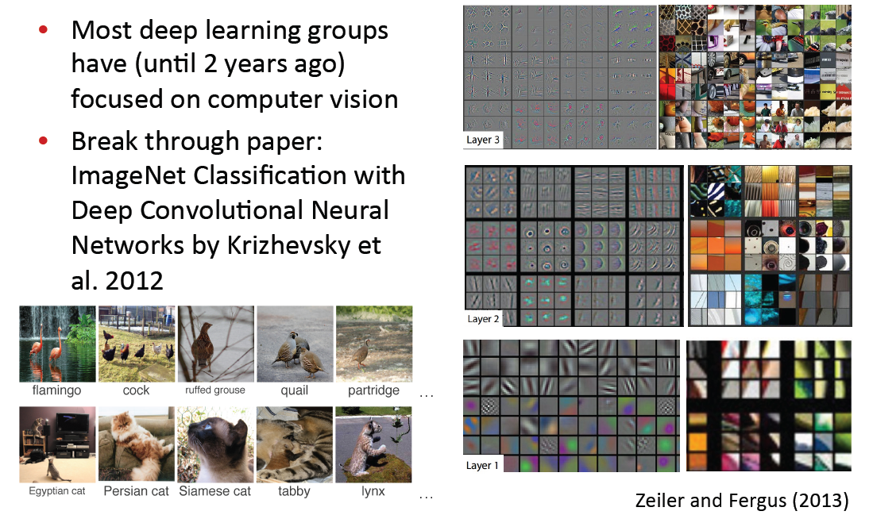
Deep Learning for Computer Vision

Slide 16
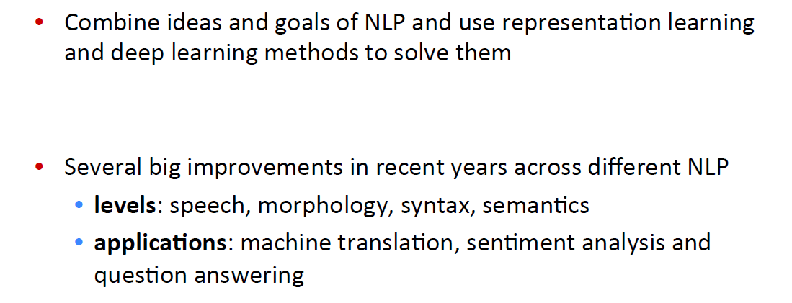
Deep Learning + NLP = Deep NLP

Slide 17
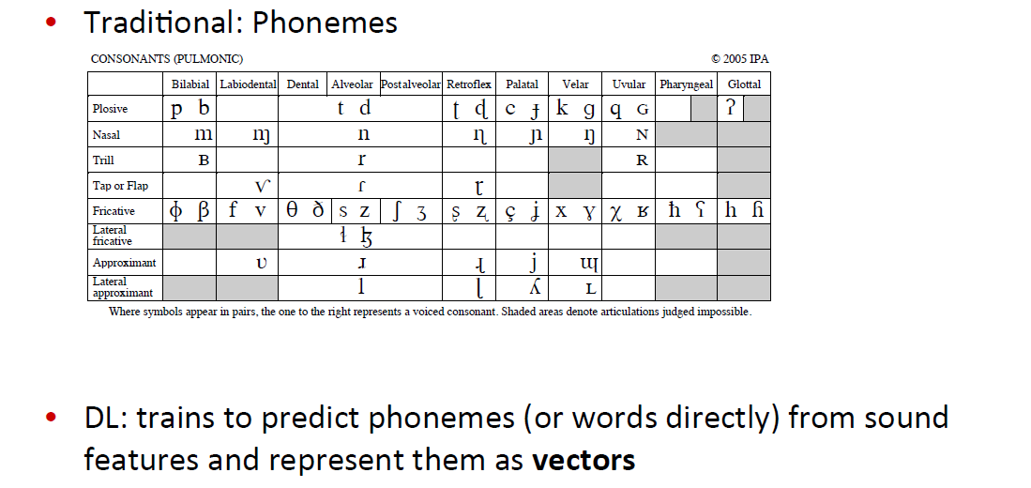
Representations at NLP Levels : Phonology

Slide 18
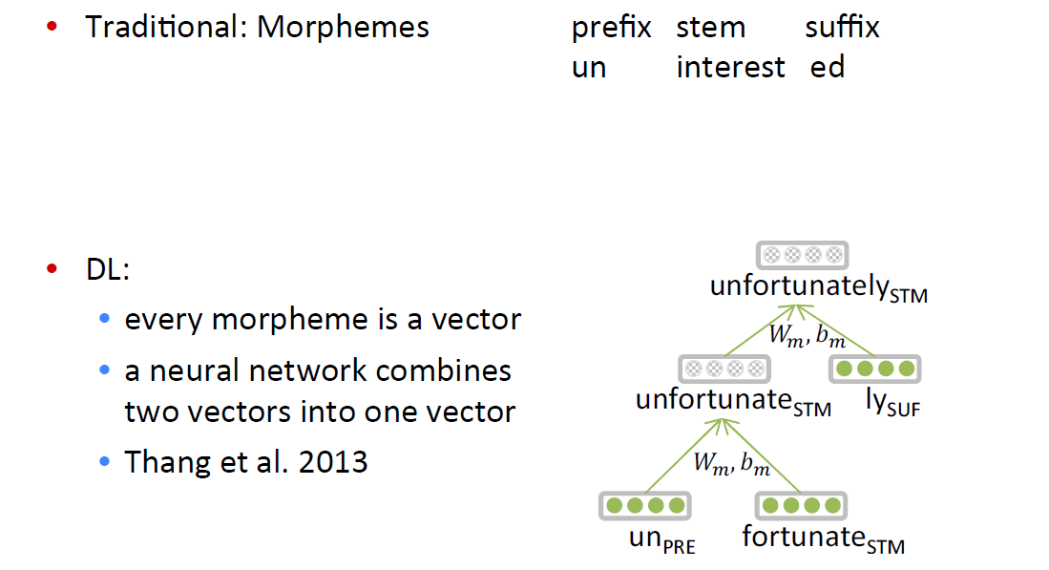
Representations at NLP Levels : Morphology

Slide 19
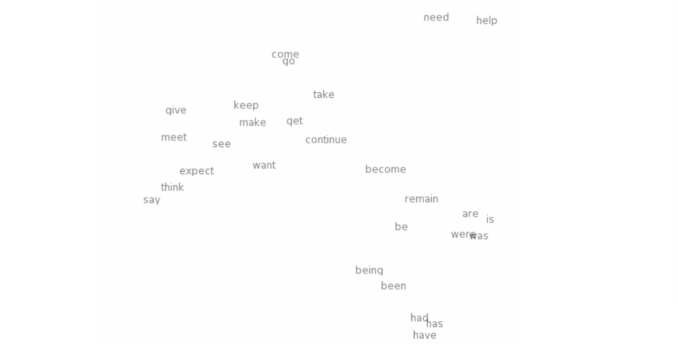
Neural word vectors - visualization

Slide 20
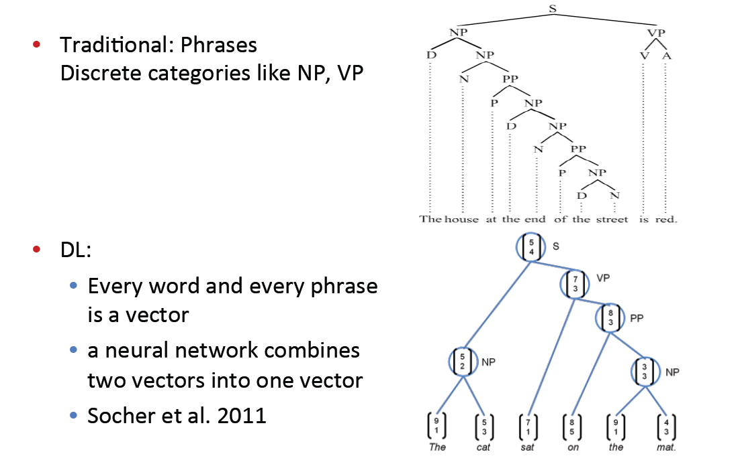
Representations at NLP Levels : Syntax

Slide 21
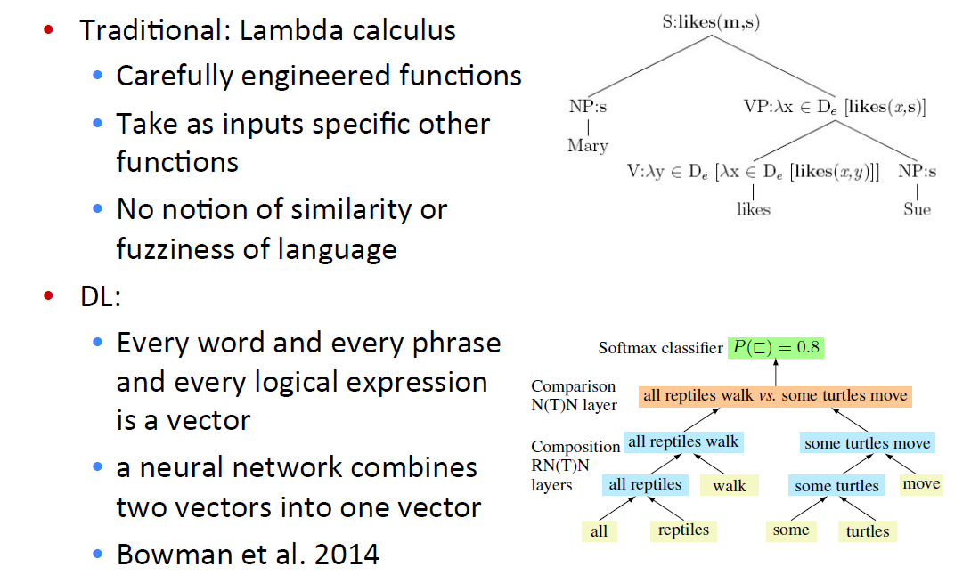
Representations at NLP Levels : Semantics

Slide 22
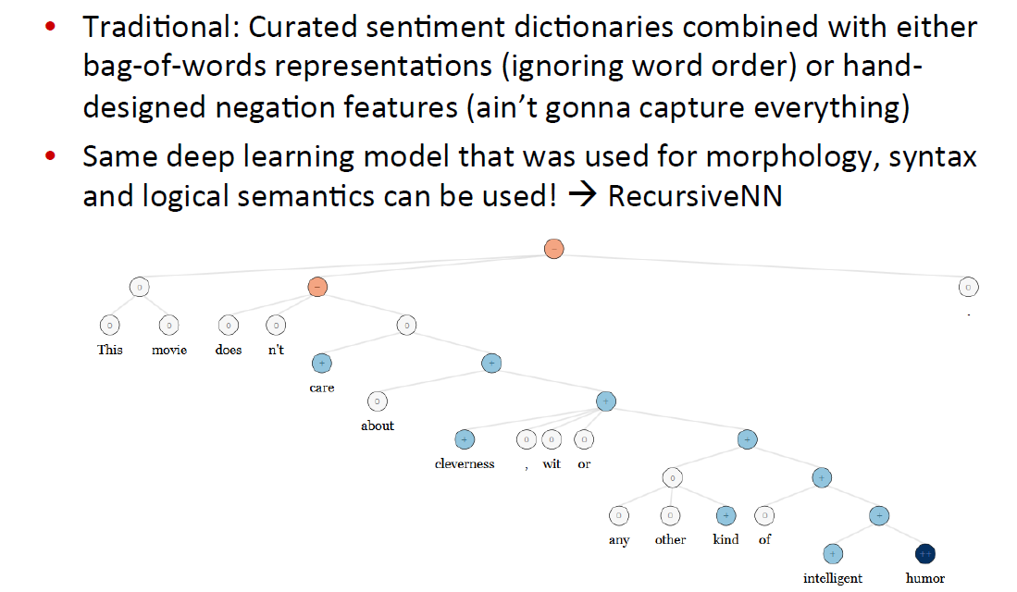
NLP Applications : Sentiment Analysis

Slide 23
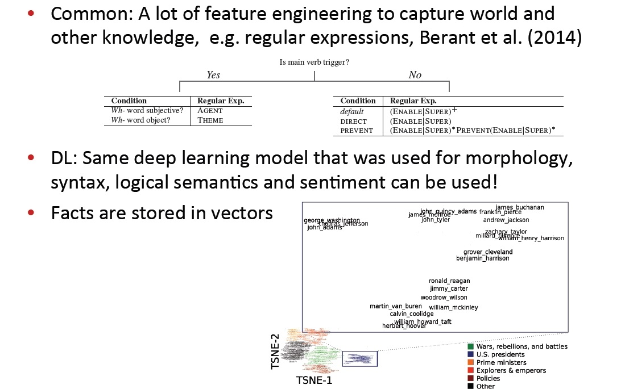
Question Answering

Slide 24
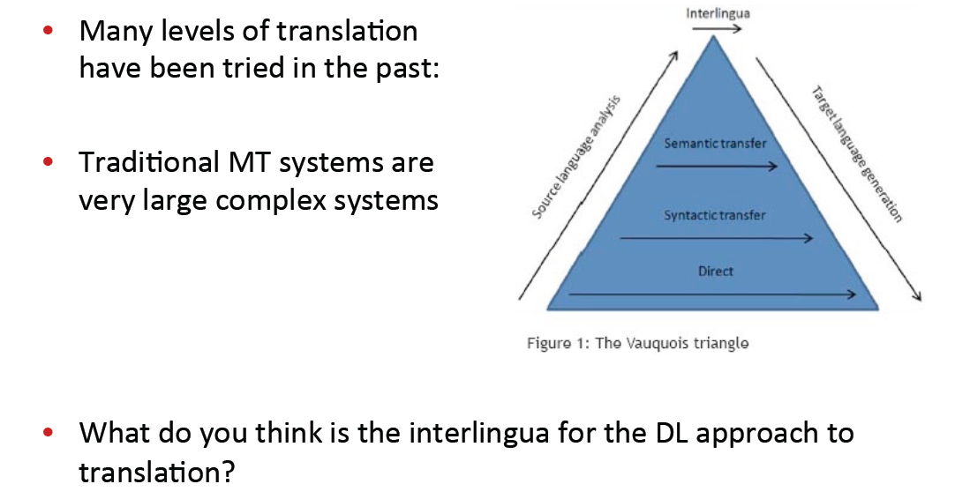
Machine Translation

Slide 25
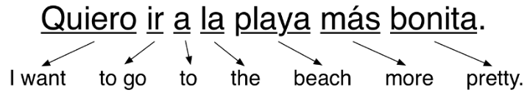
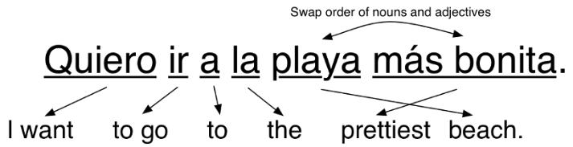
Machine Translation
Initial Machine Translation
Step 1
Step 2

Slide 26
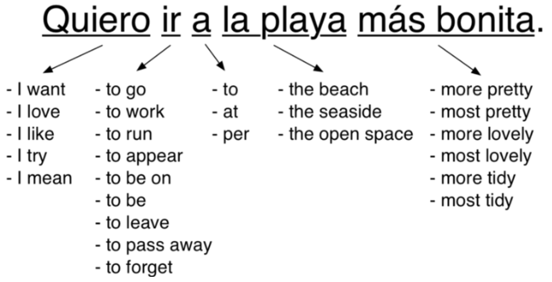
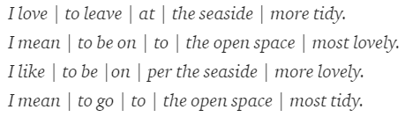
Machine Translation
Machine Translation based Statistics
Step 1
Step 2
Step 3
Step 4

Slide 27
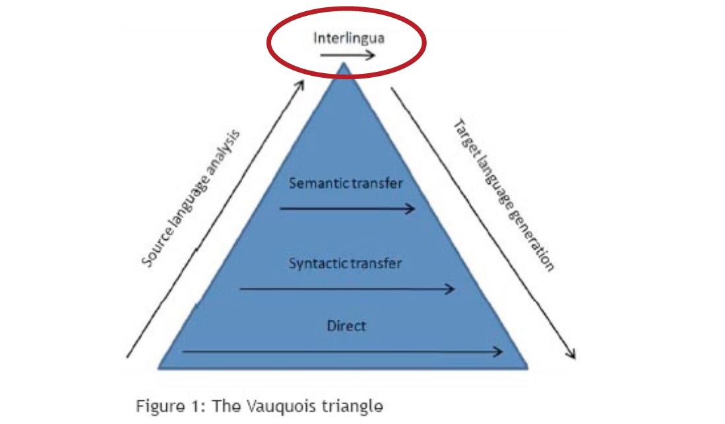
Machine Translation

Slide 28
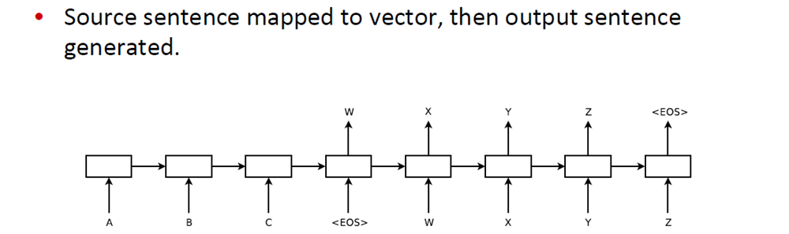
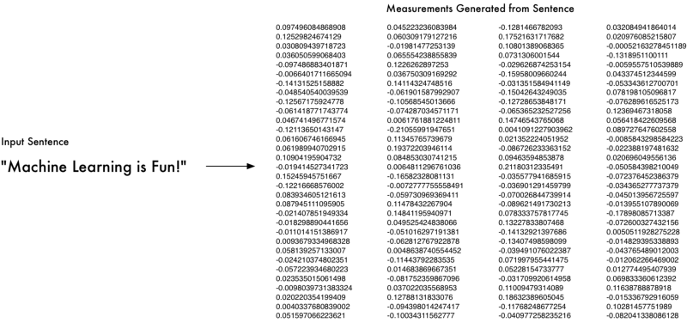
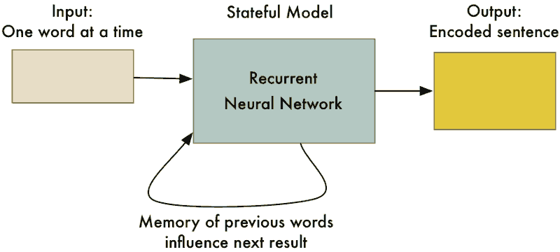
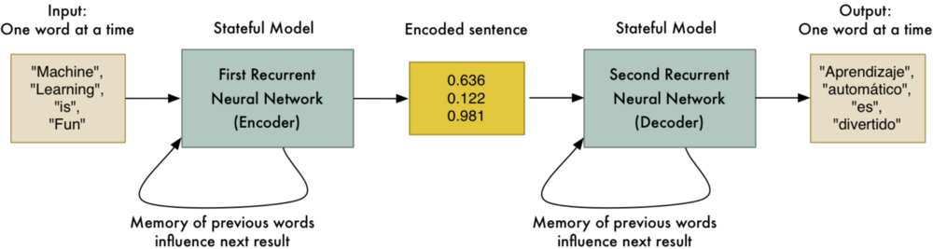
Machine Translation

Slide 29
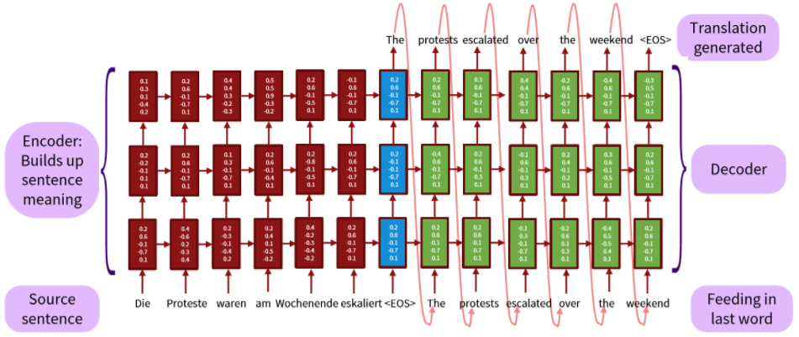
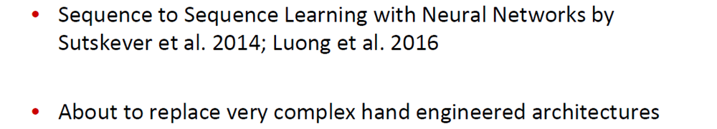
Machine Translation

Slide 30

감사합니다!
Q & A

